Slide 1
COMPUTER SCIENCE:
Youth STEM
Journal Club

Slide 2
Personal introduction:
Hi, I’m Kalena! I’m a rising Senior at Mission San Jose High School
About me:
- research for ~2 years
- ACSEF 2nd place 2025
- paper got accepted to ICML ‘25 (~27% acceptance rate)
- CFAgentic @ ICML'25
- ASB President of Mission San Jose High School (3x class prez)

Slide 3






Computer Science
the study of computation, automation, and information

Slide 4
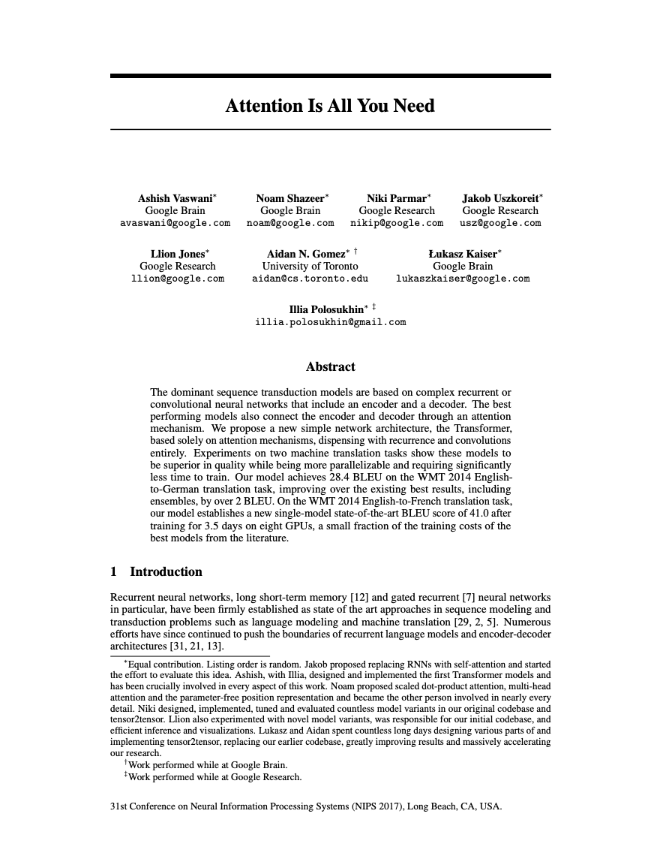
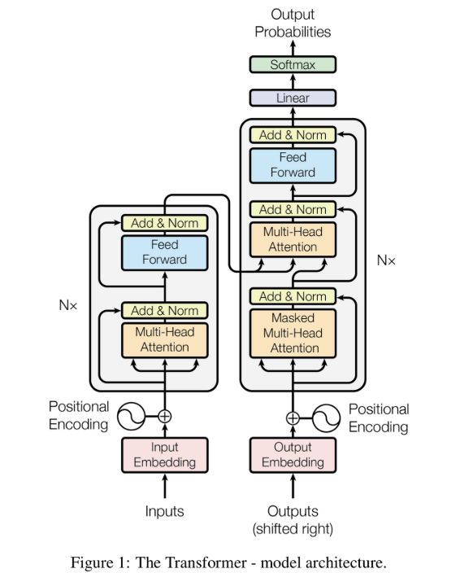

Course introduction:
What We’ll Cover:
Week 1: Introduction to Research and Transformers Attention Is All You Need (Vaswani et al., 2017)
Week 2: Deep Dive into Attention Models transformer architecture, with visual breakdowns and simple analogies.

Slide 5
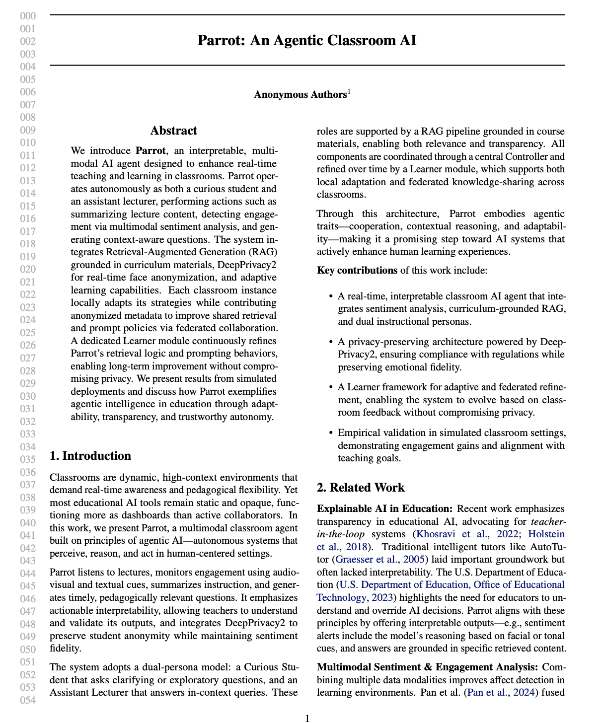
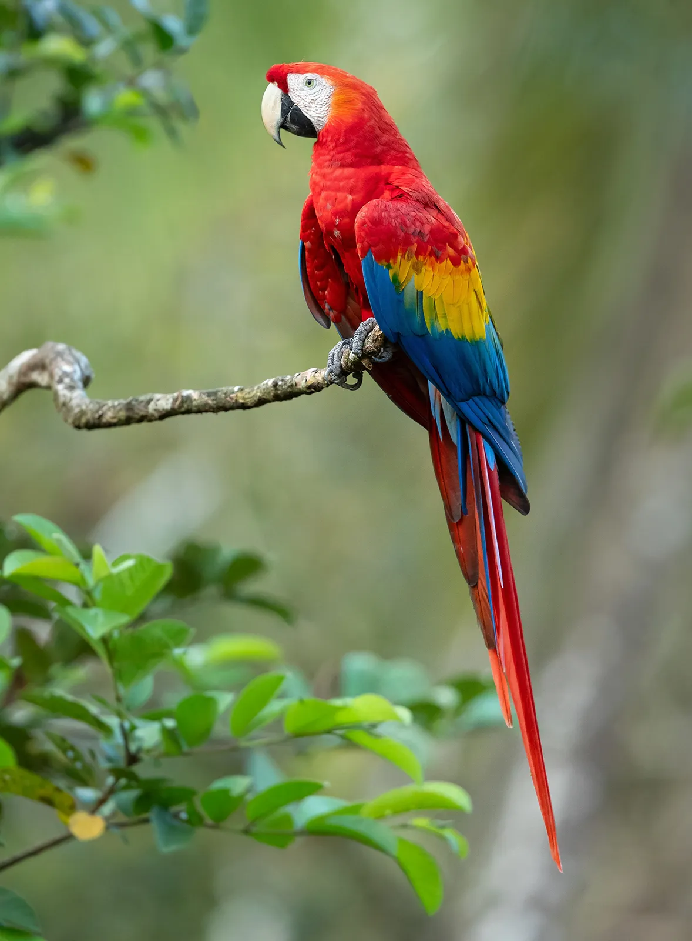
Course introduction:
Week 3: Applied AI in Classrooms Parrot: An Agentic Classroom AI, which introduces a real-world multimodal AI system designed to support education
Week 4: Critical Thinking and Presenting Scientific Ideas We’ll wrap up with group discussions about the future of AI in education and how to communicate complex topics clearly

Slide 6
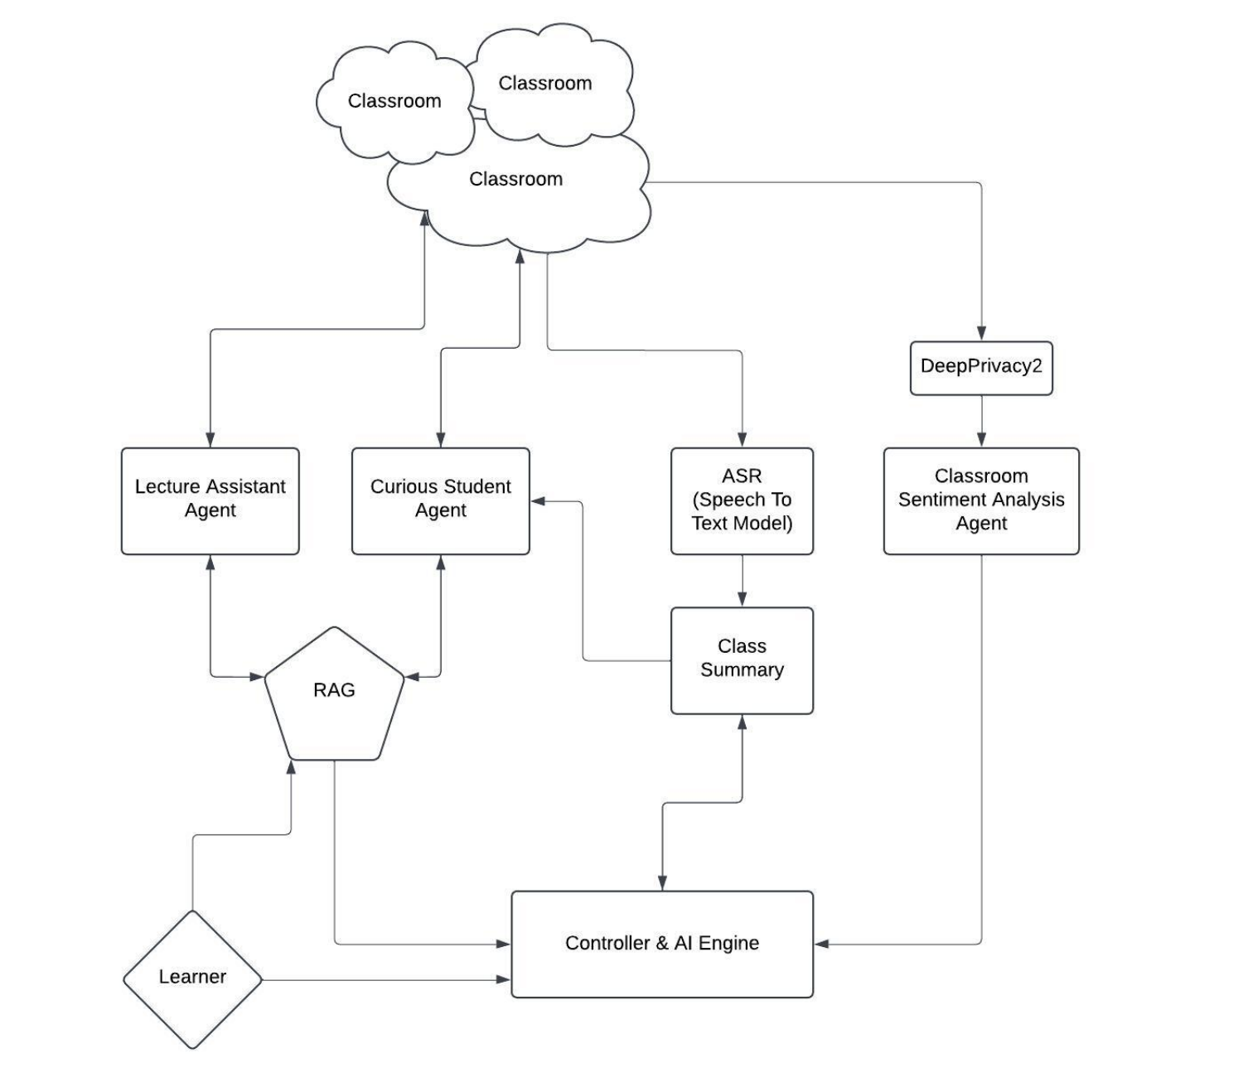
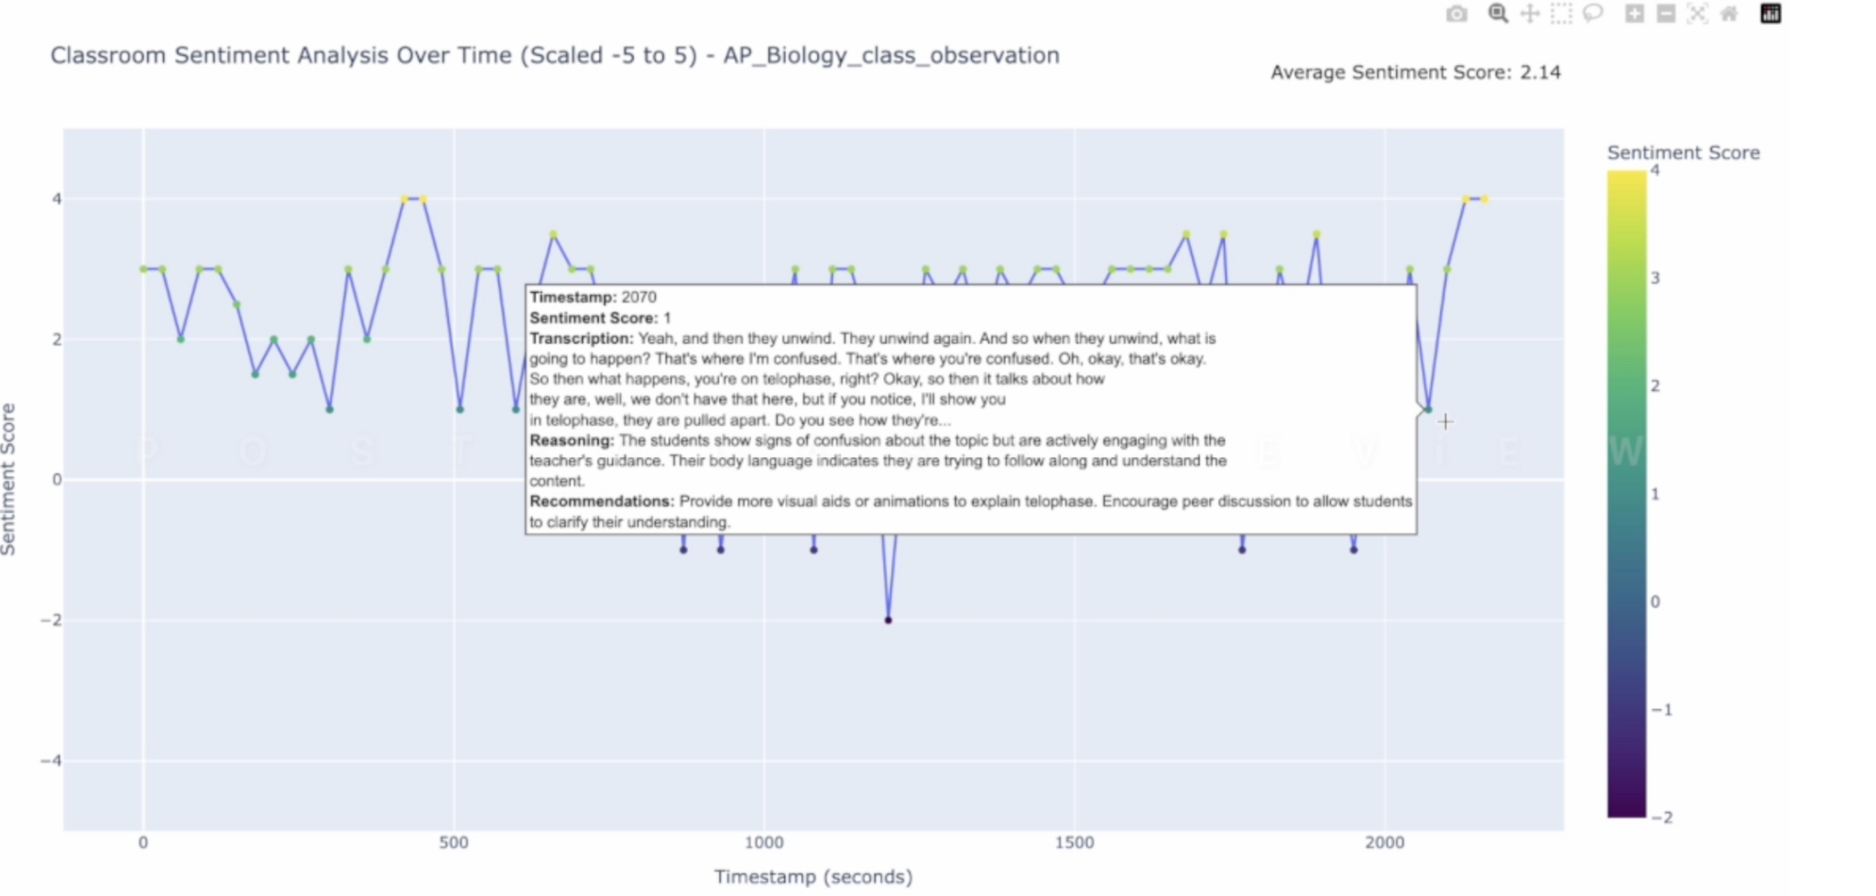
Parrot: An Agentic Classroom AI

Slide 7
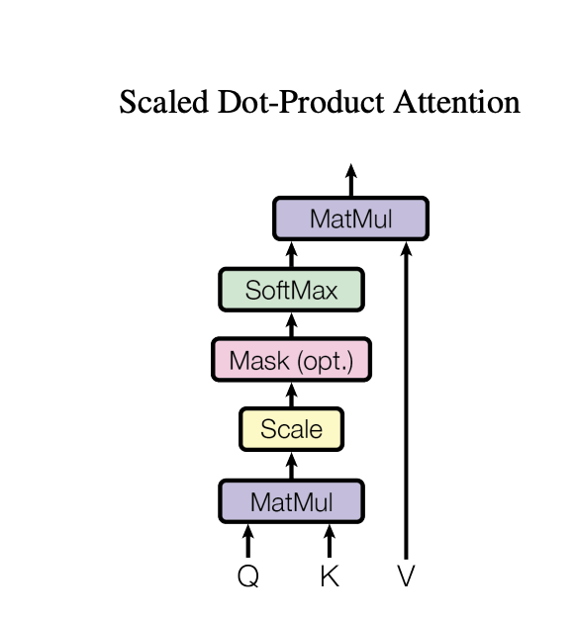
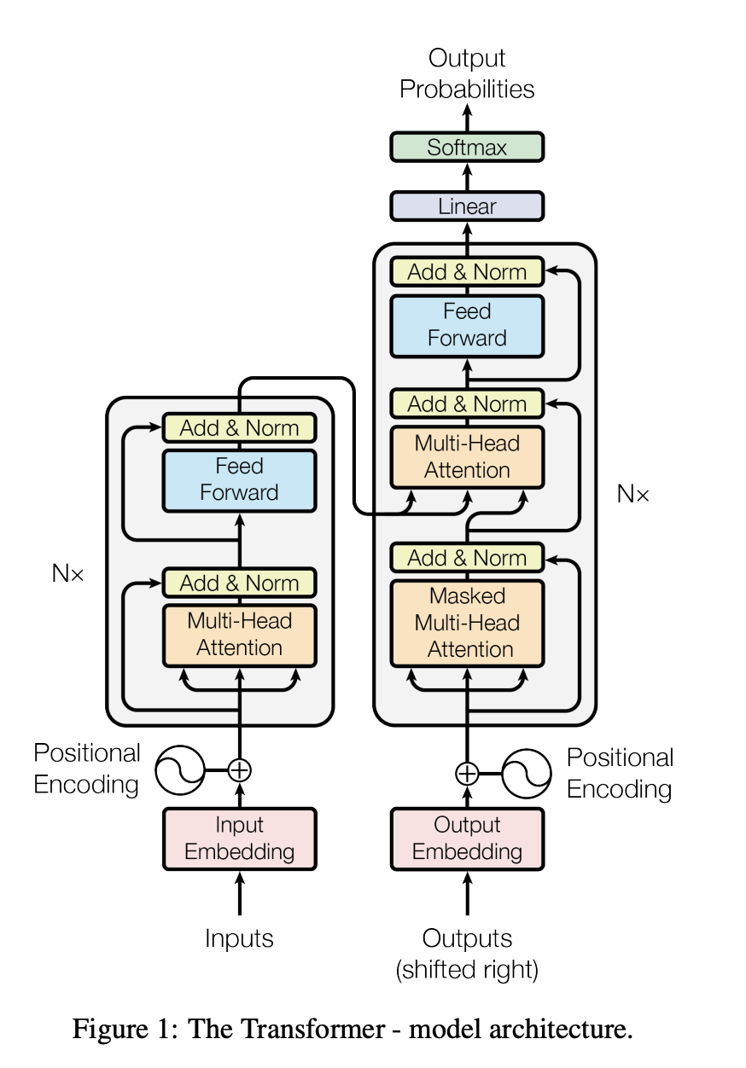
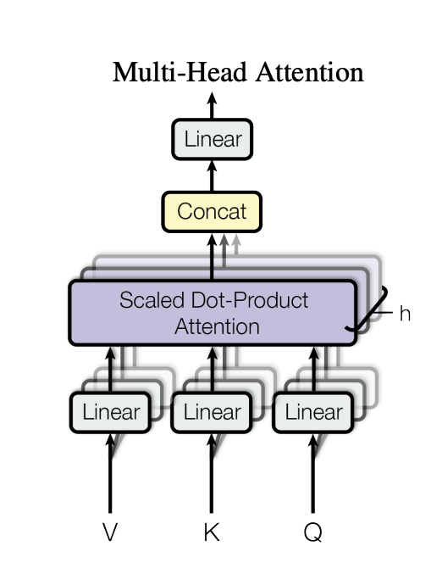
Diagrams we will be analyzing in depth:

Slide 8
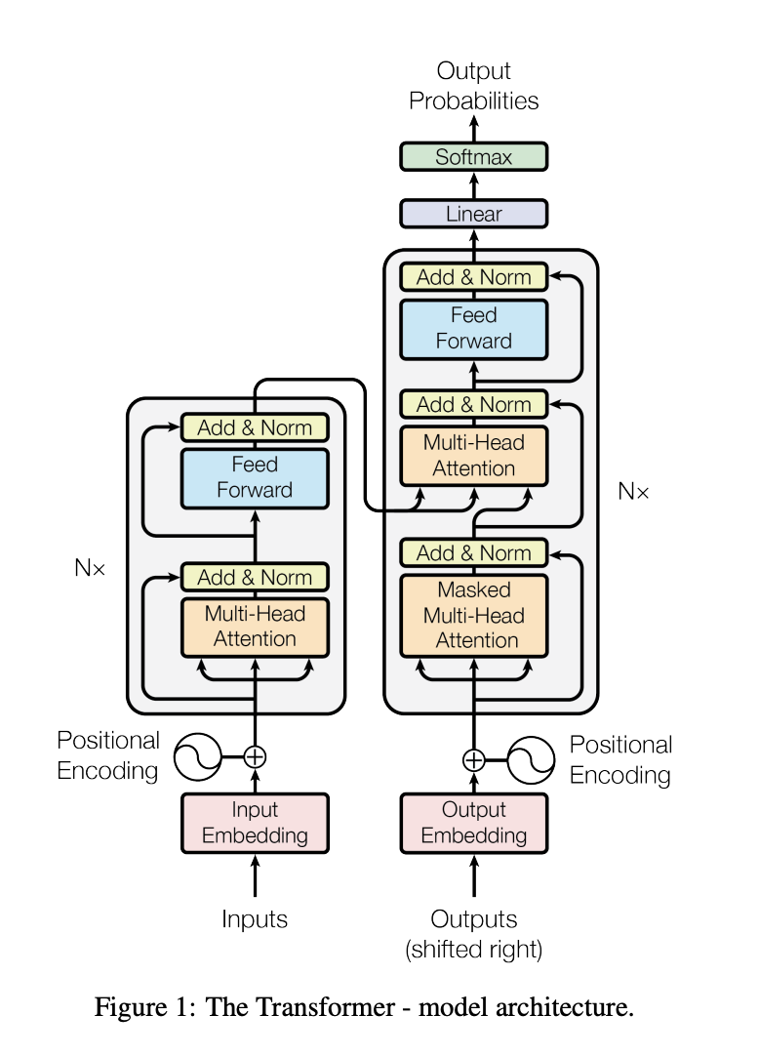
Attention Is All You Need

Slide 9
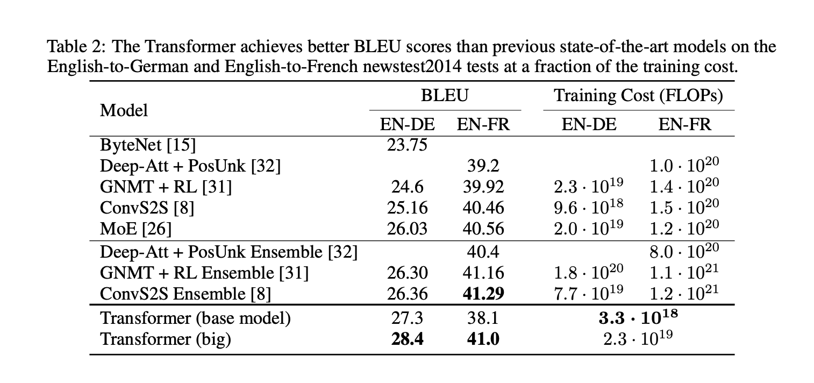
Diagrams we will not be analyzing in depth:

Slide 10


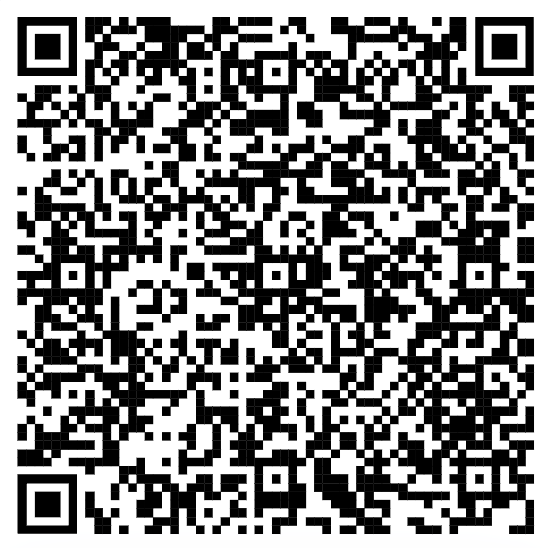
Thank you! I hope to see you all soon
My syllabus:
https://docs.google.com/document/d/1xrtgxt2QO7lMAgmnglE-MYu9hI_5NMYl50WX9q_v_ms/edit?usp=sharing

